Slide 1
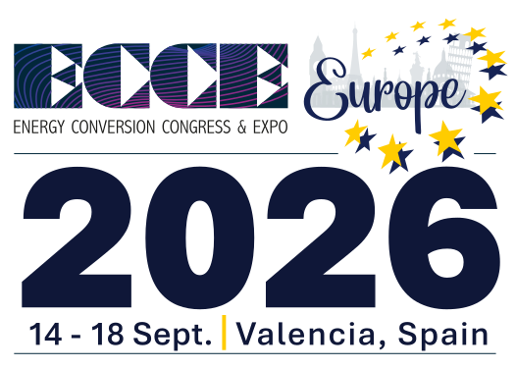


Hybrid EMI Filter for 11kW Onboard Charger
Weihao Zhao
Stefan Mollov
Michael Hartmann

Slide 2
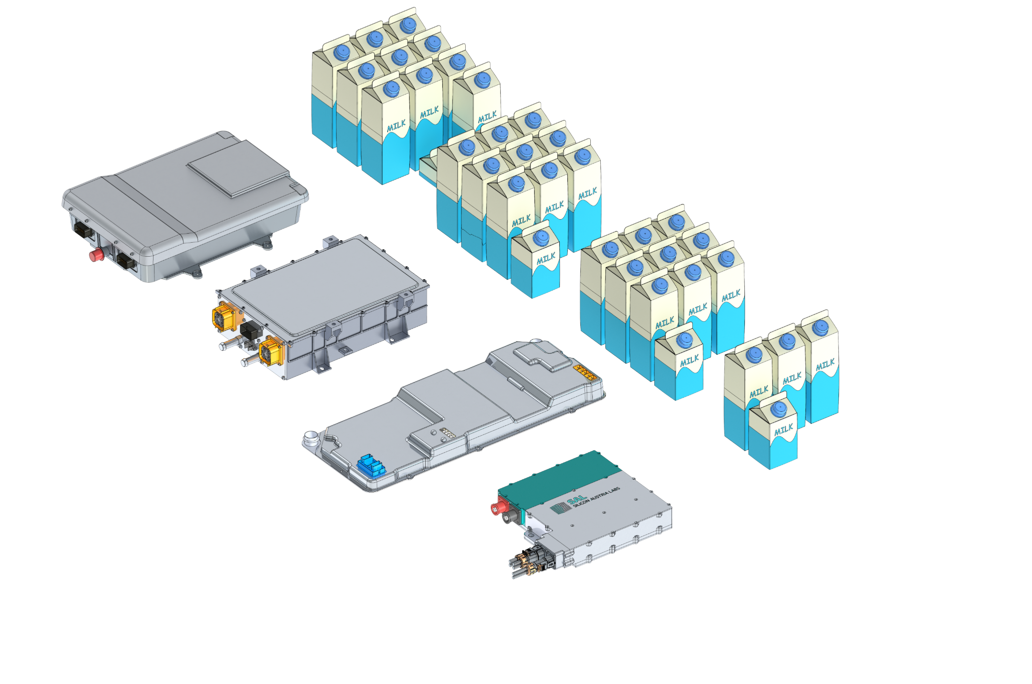

Tiny Power Box Project
*Volume indicator
High-Power Density OBC
3Φ (11kW) /1Φ (7.2kW)
IEC-61851 Compliant
Low-Profile
2.0

Slide 3
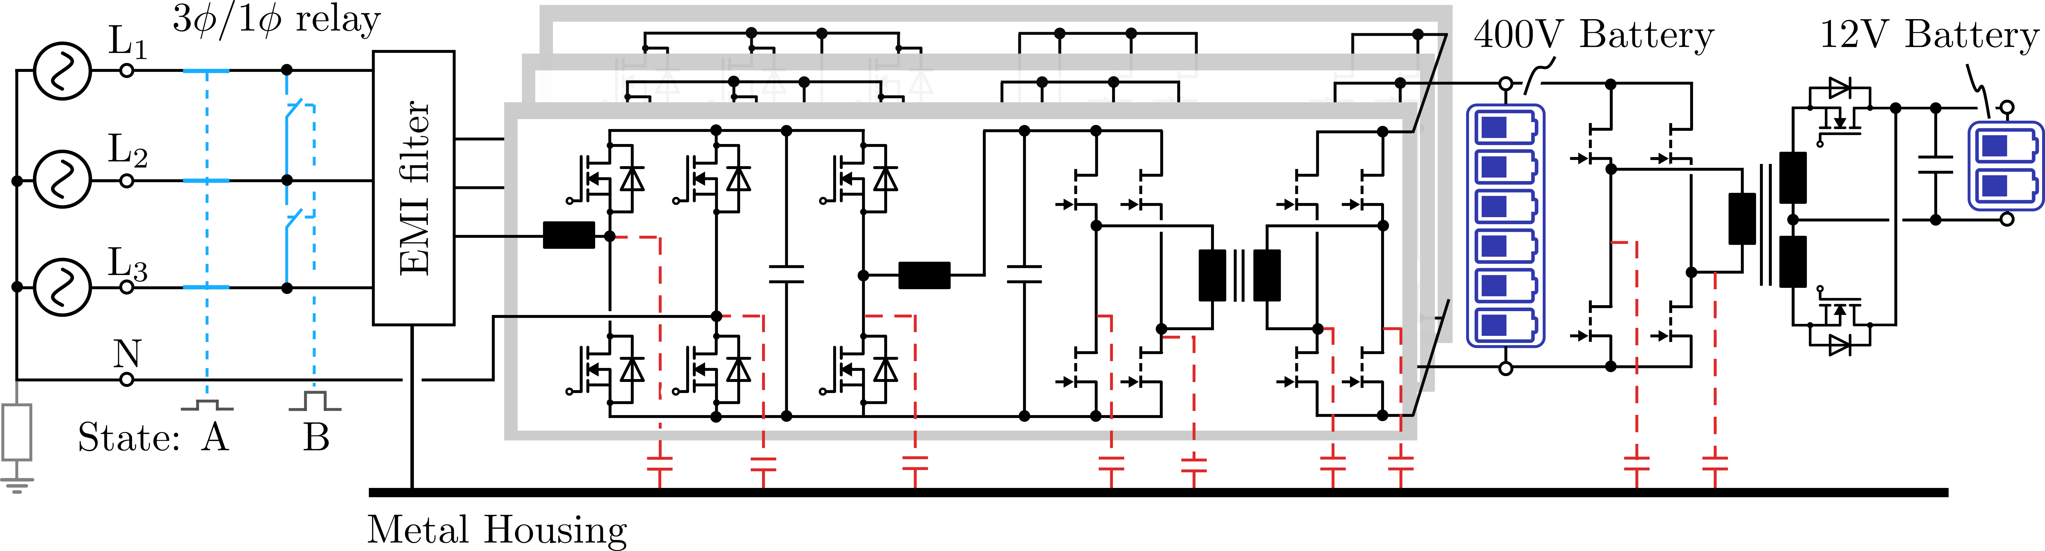
3-Φ/1-Φ Input EV Chargers
High-Power Density OBC
3Φ (11kW) /1Φ (7.2kW)
IEC-61851 Compliant
Low-Profile
IEC-61851-21-1: Conductive charging systems for electric vehicles - Part 21-1: EMC requirements for on-board chargers for AC/DC powered electric vehicles

Slide 4
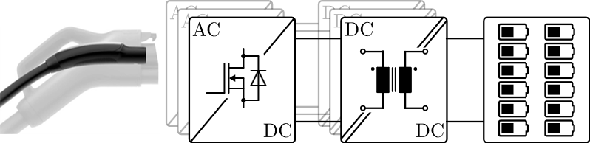
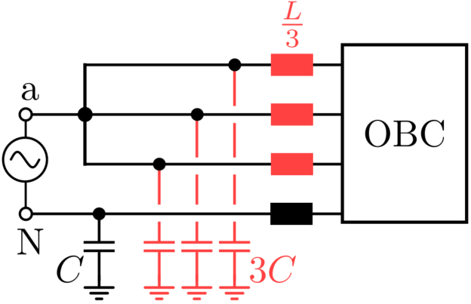
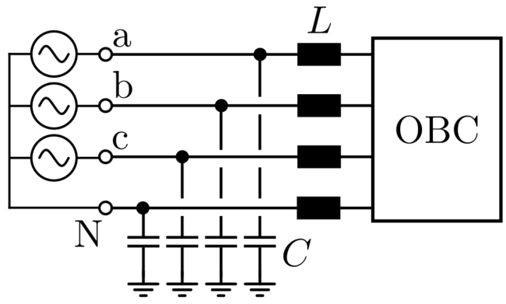
Design Challenges
3Φ/1Φ Input Compatible
3Φ Mode
1Φ Mode

Slide 5
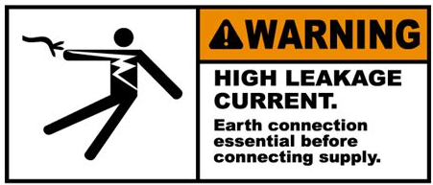
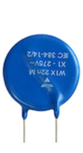
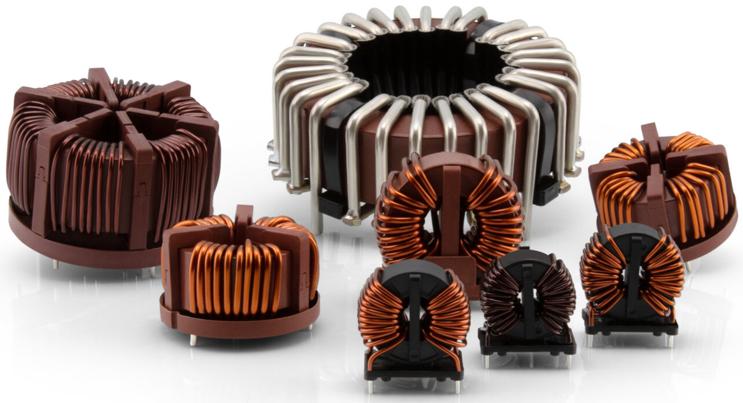
Design Challenges
3Φ/1Φ Input Compatible
Low Leakage Current^{[1]}
1. IEC 61851-1, Electric Vehicle Conductive Charging System-Part I General Requirements

Slide 6
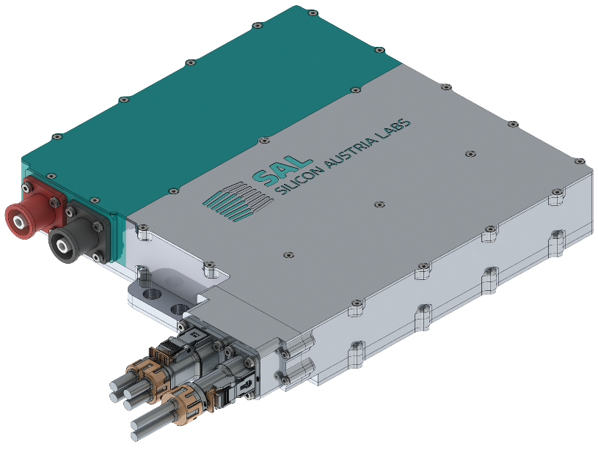
Design Challenges
3Φ/1Φ Input Compatible
Low Leakage Current^{[1]}
Strict Volume Restriction
250mm
270mm
50mm
Z
Y
X
1. IEC 61851-1, Electric Vehicle Conductive Charging System-Part I General Requirements

Slide 7
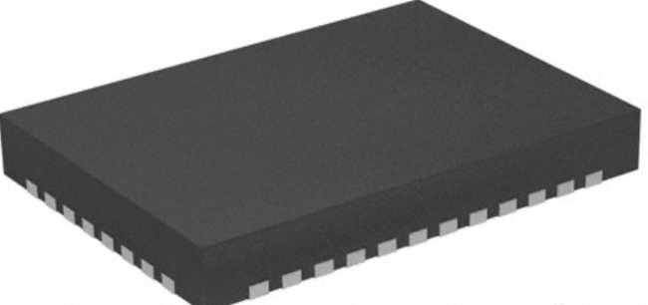
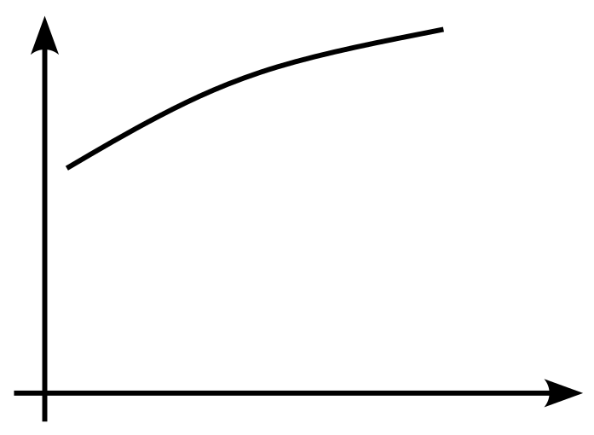
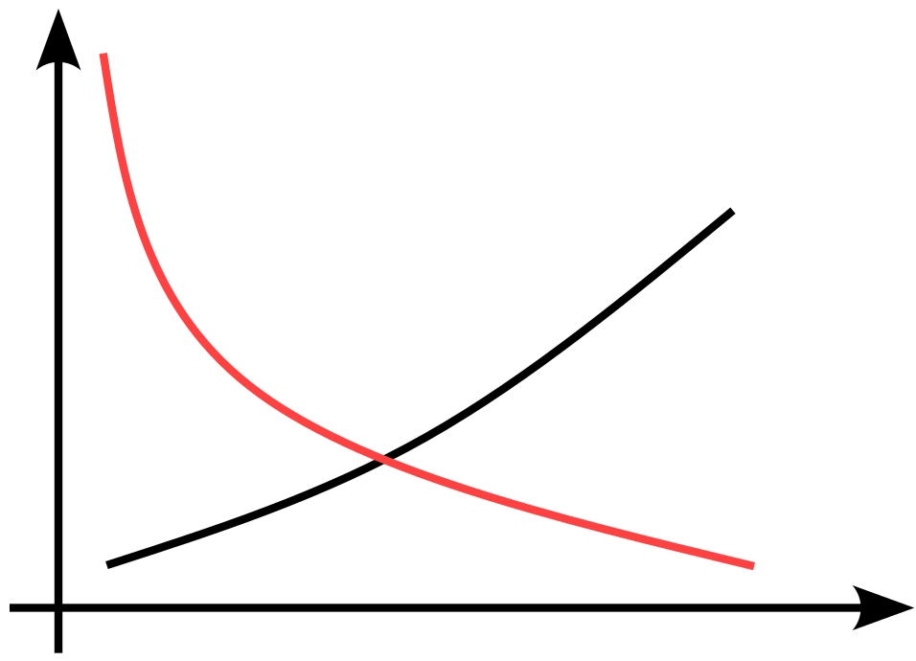
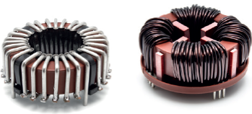
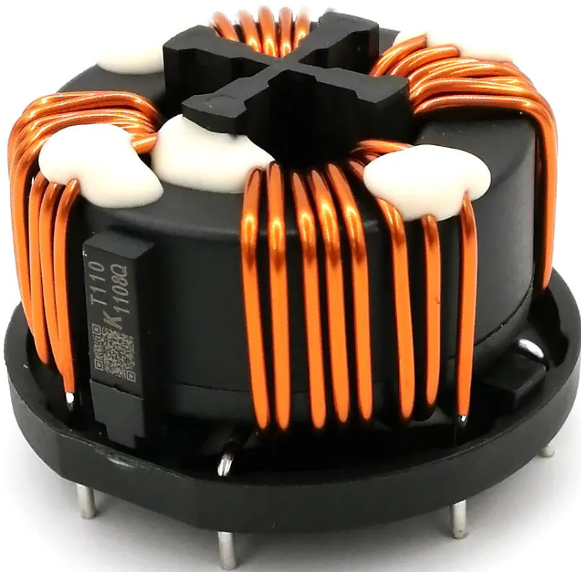
Solution
Passive EMI Filter
Hybrid EMI Filter
Passive Filter
Active Filter
Attenuation (dB)
Attenuation (dB)
Passive Filter
Frequency
Frequency
https://vacuumschmelze.com/products/inductive-components-and-cores/amorphous-and-nanocrystalline-cores

Slide 8
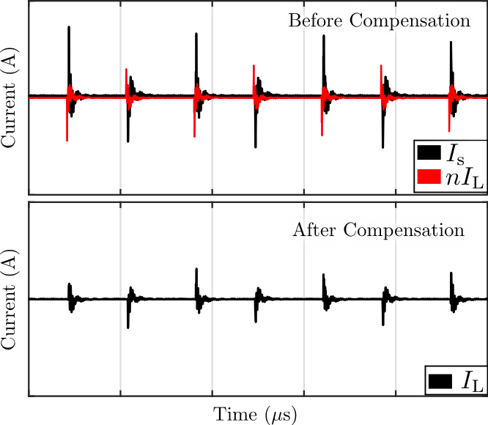
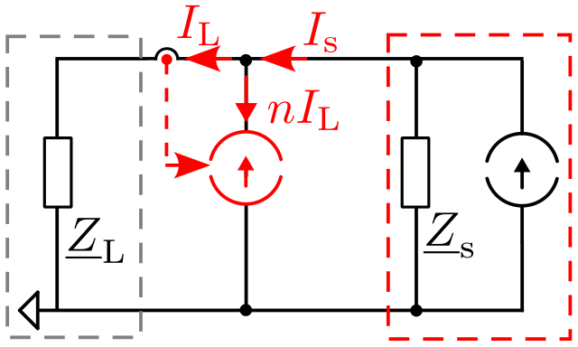
Active EMI Filter
  Measurement
  Processing
  Compensation
LISN
DUT
W. Zhao and M. Hartmann, "Design and Implementation of An Active Common Mode EMI Filter for LV Automotive Applications," PCIM 2025, Germany.

Slide 9
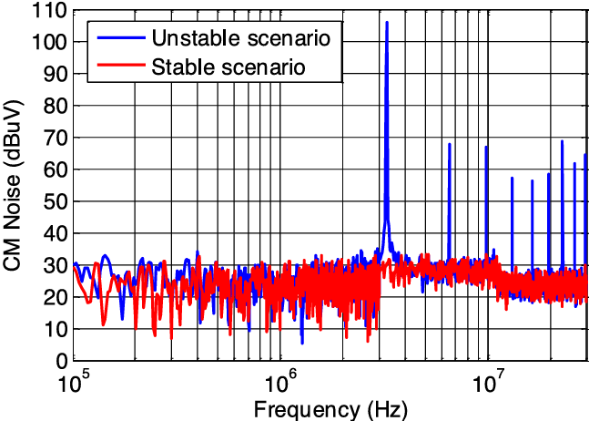
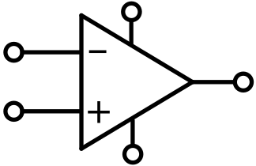

Design Consideration
Output Capability
Stability
Adaptability
Y. Chu, S. Wang and Q. Wang, "Modeling and Stability Analysis of Active/Hybrid Common-Mode EMI Filters for DC/DC Power Converters," IEEE TPEL, 2016.

Slide 10
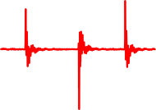

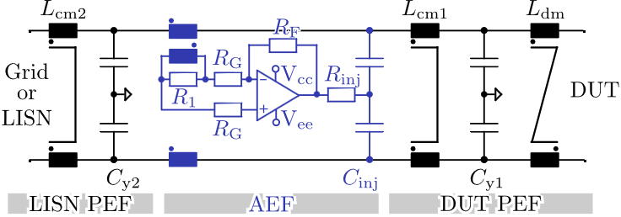
Design Consideration
Output Capability
Stability
Adaptability
~μA
~mA
~ A

Slide 11
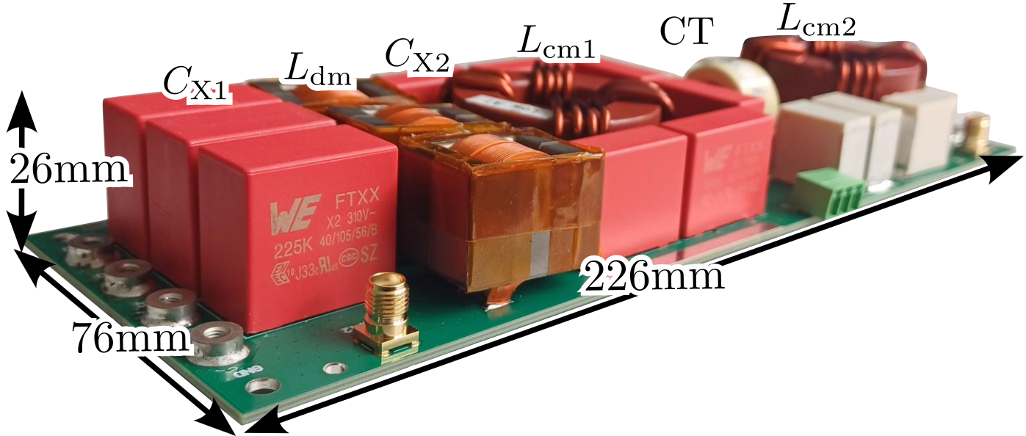
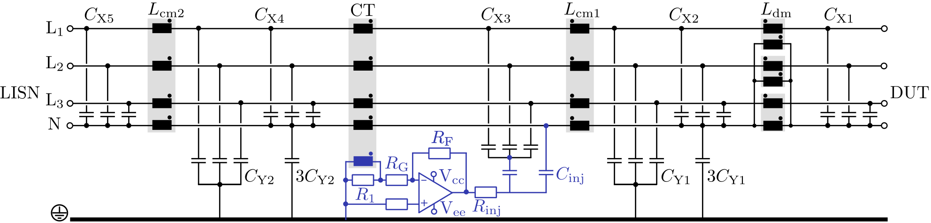
11kW Hybrid Filter (3Φ Mode)
3Φ/1Φ Input Compatible
1.3mA Leakage Current

Slide 12
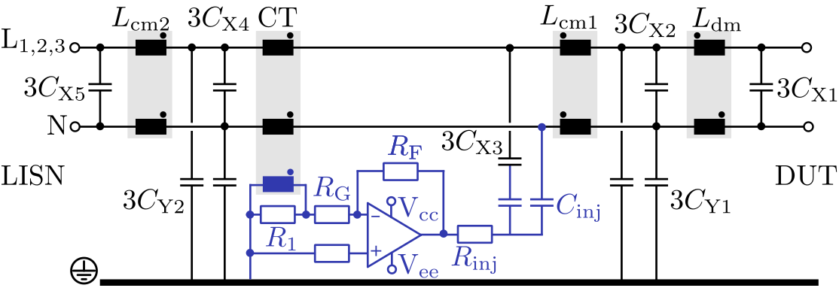
11kW Hybrid Filter (1Φ Mode)
3Φ/1Φ Input Compatible
1.3mA Leakage Current

Slide 13
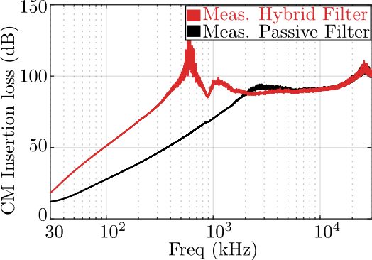
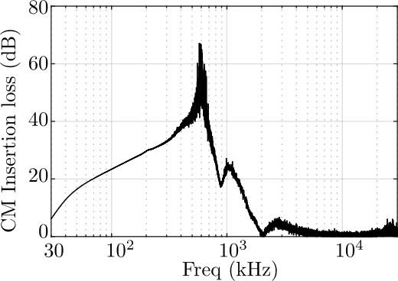
Insertion Loss Measurement
Effective 30kHz-2MHz
45dB improvement @450kHz
Active Filter

Slide 14
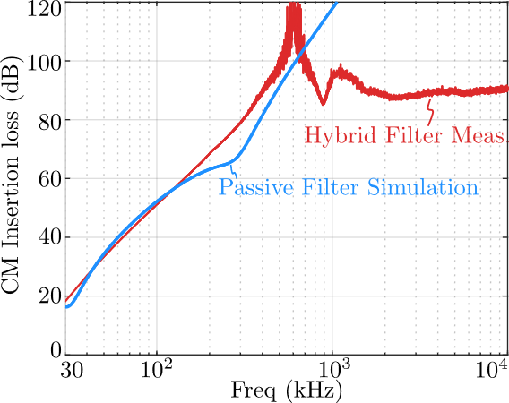
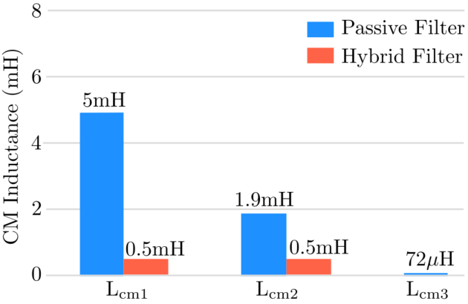
Benchmark Passive Filter
Lcm1 reduced by 90%
Lcm2 reduced by 75%

Slide 15
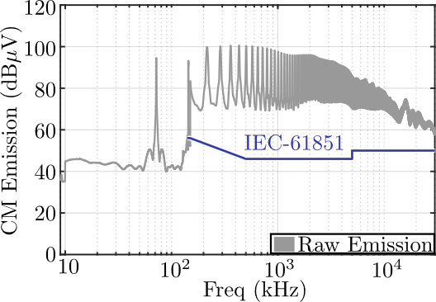
Conductive Emission Measurement
50dB attenuation required
Copper Plane
LISN
DUT
EMI Receiver

Slide 16
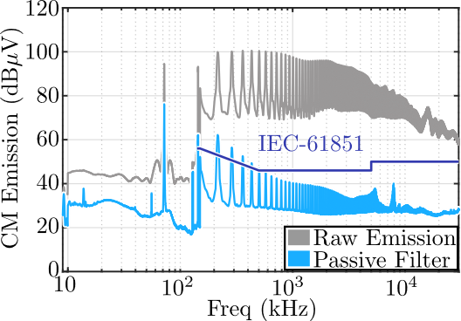
Conductive Emission Measurement
10dB violation in 150kHz-600kHz
HF Noise is reduced
Copper Plane
LISN
PEF
DUT
EMI Receiver
*PEF: Passive EMI Filter

Slide 17
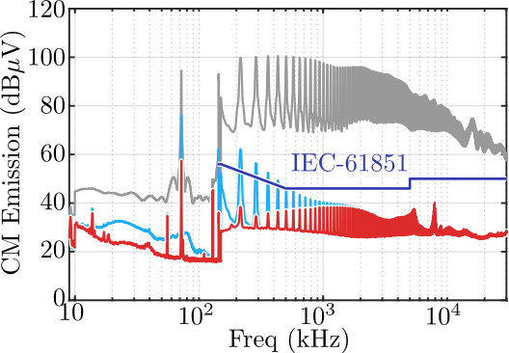

Conductive Emission Measurement
Effective 9kHz-1MHz
27dB@150kHz
Copper Plane
LISN
HEF
DUT
EMI Receiver
*HEF: Hybrid EMI Filter

Slide 18
Conclusion
Hybrid EMI Filter New Design Option
  Volume/Weight Reduction
  Higher Attenuation
  Higher Power Density
Passive Filter
Hybrid Filter
https://vacuumschmelze.com/products/inductive-components-and-cores/amorphous-and-nanocrystalline-cores

Slide 19
Questions

Slide 20
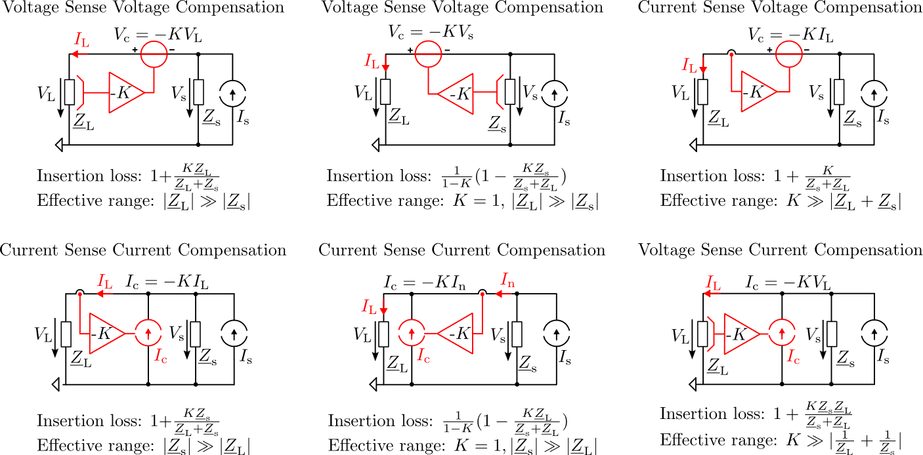
Active EMI Filter Design
Notes:
Top row, the compensation signal is voltage
Bottome row, the compensation signal is current

Slide 21

Conclusion
3Φ /1Φ Comptible 11kW Hybrid EMI Filter
  Inductance reduced by 90%
  27dB attenuation improvement @150kHz
  Effective from 9kHz-1MHz
  Low-Profile Filter Design (26mm)
Passive Filter
Hybrid Filter

Slide 22

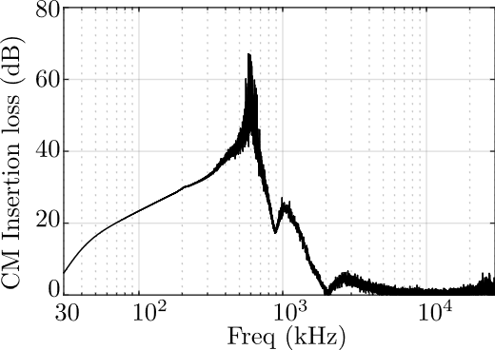
Insertion Loss Measurement
Vector Network Anlyzer
Hybrid Filter

